Slide 1

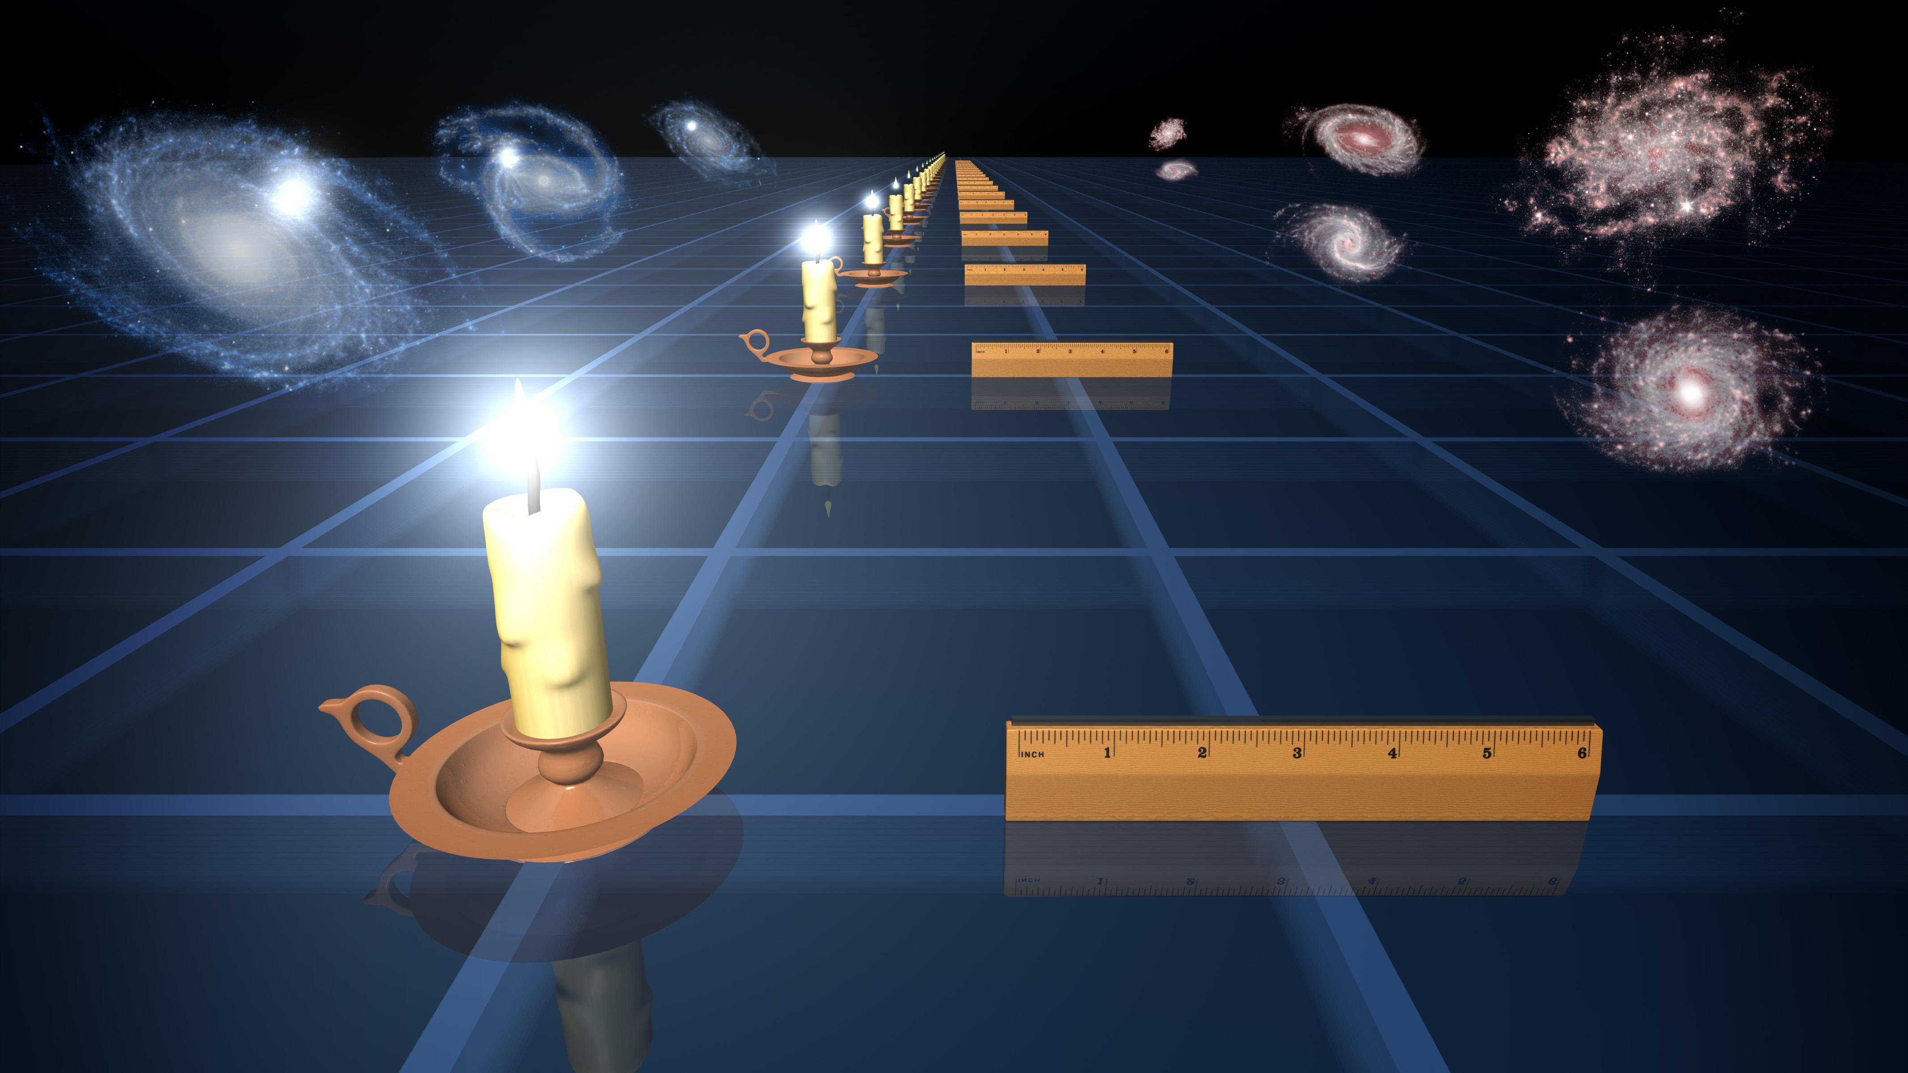
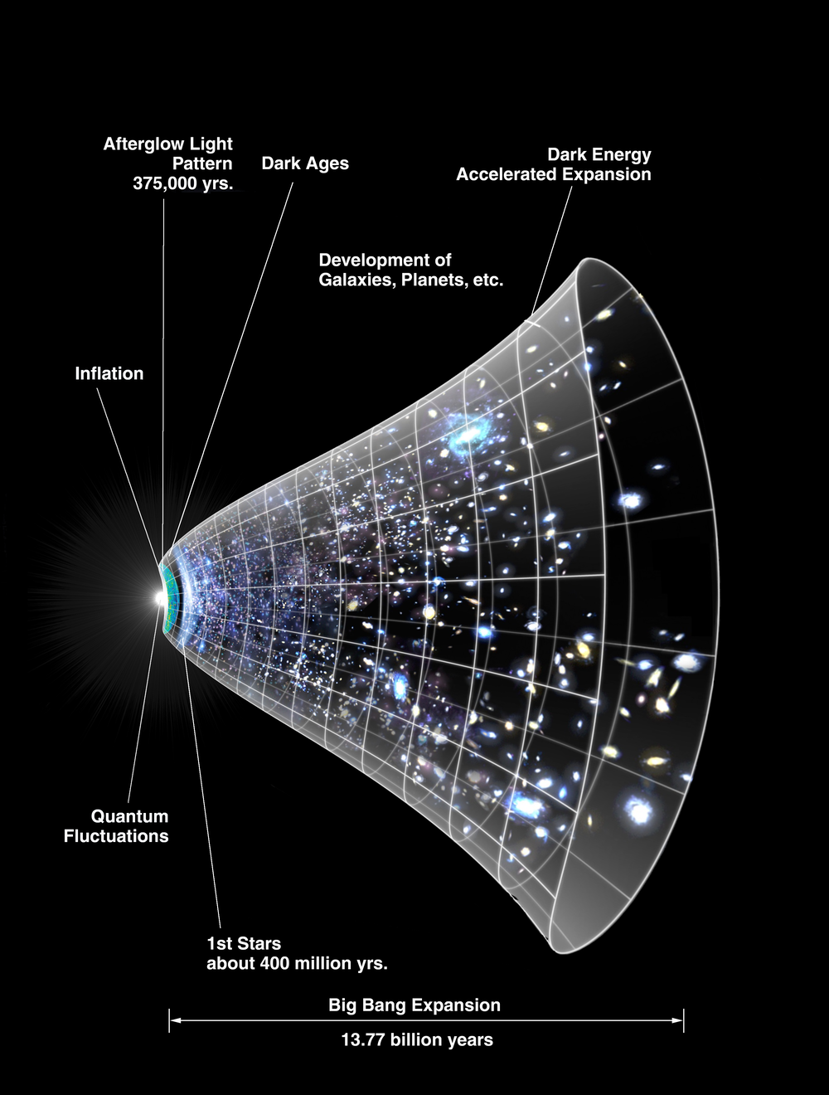


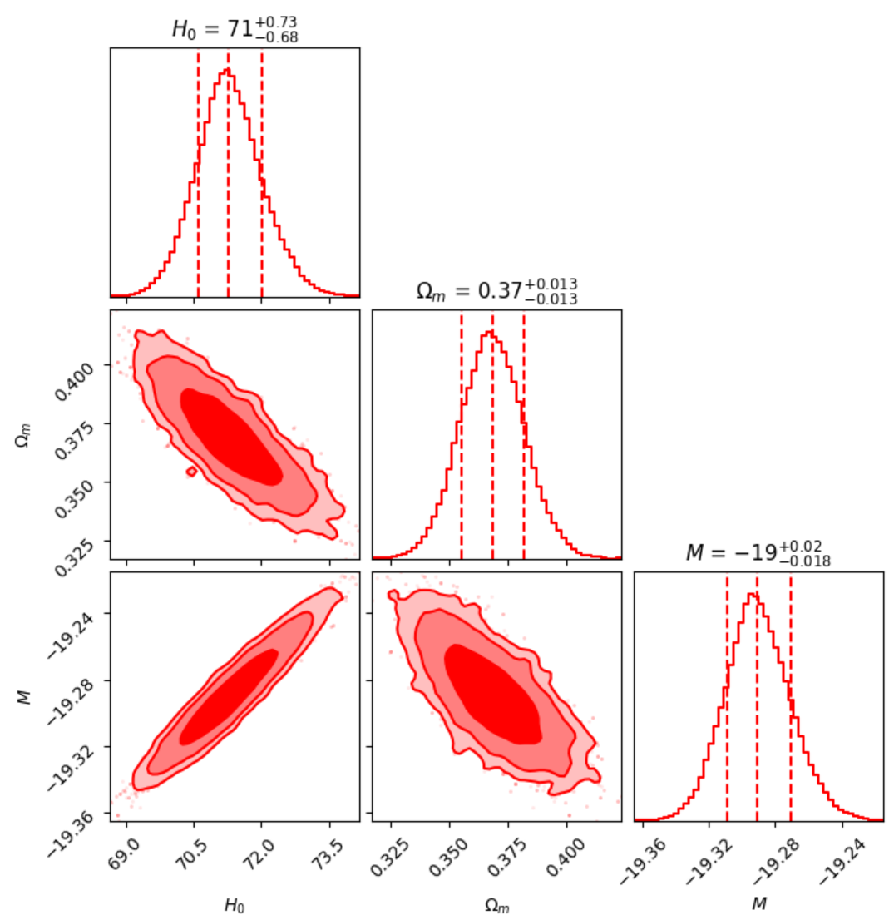



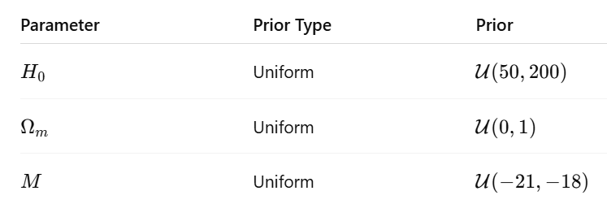


MAPPING THE LATE-TIME UNIVERSE :
ΛCDM CONSTRAINTS FROM COSMIC BEACONS
Abhilipsa Patra, Anveeta Mohanty, Ayushi Gupta, Ms. Bhumika
B.Sc. (H) Physics, Miranda House
Mentors: Dr. Abha Dev Habib and Dr. Nisha Rani
DSKC SIP 2025
ABSTRACT
In this project, we aim to reproduce and verify some interesting results of the paper [1] .The work focuses on affirming the results of ΛCDM model, collecting data from SNe Ia, CC, QSO, BAO, and replicating the methodology of original paper to verify the estimated best fit value of Hubble constant (H0) and matter density (Ωm) using statistical tools like Chi-Square analysis and MCMC sampling method.
COSMOLOGICAL MODEL
DATASETS AND OBSERVABLES
ΛCDM (Lambda Cold Dark Matter) is the standard cosmological model. It assumes:
The key parameters you’re constraining (e.g., H0​, Ωm, and ΩΛ​) define the expansion history of the universe and the relative contribution of matter (Ωm) and dark energy (ΩΛ).
This model is considered better because of its
simplicity, consistency with observations and
free parameters.
Type Ia Supernova (SNe Ia)
Λ (Lambda): A cosmological constant, representing dark energy responsible for the accelerated expansion of the universe.
CDM: Cold Dark Matter — the dominant matter component.
Type 1a Supernova is the result of a white dwarf star gaining too much mass from a companion star and undergoing a thermonuclear explosion. This is useful to understand the structure, expansion, and fate of the universe. Their consistent brightness makes them “standard candles” (used to calculate distances to far away galaxies).
Calculations of distance using standard candles
Cosmic Chronometer (CC)
Acting like a cosmic clock, it helps scientists determine how fast the universe was expanding at various times. By measuring the differential age of galaxies, they can directly calculate the Hubble parameter (H(z)) at a given redshift (z).
METHODOLOGY
Quasars (QSO)
Quasars are ultra-bright, energetic objects powered by supermassive black holes, acting like cosmic lighthouses. They're observed across vast distances through apparent magnitude (m) and used to derive their absolute luminosity (L).
We constrain the ΛCDM model using a Bayesian framework that incorporates late-time cosmological datasets.
1. ΛCDM Model Assumptions:
Baryonic Acoustic Oscillations (BAO)
The ΛCDM model describes a flat universe dominated by cold dark matter and a cosmological constant Λ, with the dark energy equation of state fixed as
Baryon Acoustic Oscillations, caused by early-universe fluctuations in baryonic matter, leave imprints which provide precise distance measurements across redshifts, helping to determine the cosmic parameters like the Hubble constant and matter density to study the current universe expansion.
This represents a constant vacuum energy density driving the universe's accelerated expansion.
2. Parameter Estimation:
Free parameters: H0: Hubble constant Ωm: Matter density M: Absolute magnitude (SNe Ia)
RESULTS & ANALYSIS
3. Bayesian inference
We obtained posterior constraints on the ΛCDM parameters using a combined dataset :
SNe Ia, BAO, CC and QSO.
We use Bayes’ theorem to infer posterior probability:
The marginalized parameter estimates (68% credible intervals) are:
where θ={H0, Ωm, M}
Chi square estimation
The corner plot shows well-constrained posteriors and correlations among parameters.
The use of multiple late-time datasets significantly improves the precision of parameter estimation.
For each dataset, the chi-square is calculated as:
The total chi square of combined datasets can be calculated as:
Likelihood construction
INTERPRETATION
MCMC Sampling using emcee
The estimated values of H0 and Ωm are closely consistent with the referred paper [1].
The combination of SNe Ia, BAO, CC, and QSO data yields tight, CMB-independent constraints, demonstrating the power of late-time cosmological probes.
The priors are considered as
Our results from Pantheon+, DESI BAO, QSO, and CC datasets constrain Ωm​ and H0​ in support of the ΛCDM model. The inferred ΩΛ = 1− Ωm​ confirms the presence of dark energy driving late-time cosmic acceleration. Tight bounds on H(z) further validate ΛCDM as a consistent model with current observations.
We define the log-posterior as:
Figure1: Corner plot showing marginalized 1D posterior distributions and 2D confidence contours for H0​, Ωm​, and M.
We use emcee to sample the posterior distribution based on our log-likelihood and priors. The output chains are used to extract statistical constraints and visualize parameter correlations via corner plots.
FUTURE WORK
REFERENCES
Statistical techniques such as MCMC and chi-square analysis are not only vital for advancing future cosmological research but also hold broad applicability across various scientific domains, parameter estimation and model evaluation in complex, data-driven investigations.
Barua, S., & Desai, S. (2025). Constraints on Dark Energy Models Using Late Universe Probes. arXiv:2506.12709 (Includes QSO, CC , BAO datasets)
https://github.com/PantheonPlusSH0ES/DataRelease (includes Pantheon plus datasets)
https://www.space.com/2024-finally-understand-dark-energy
Barua & Desai (2025) arXiv:2506.12709

